Slide 1
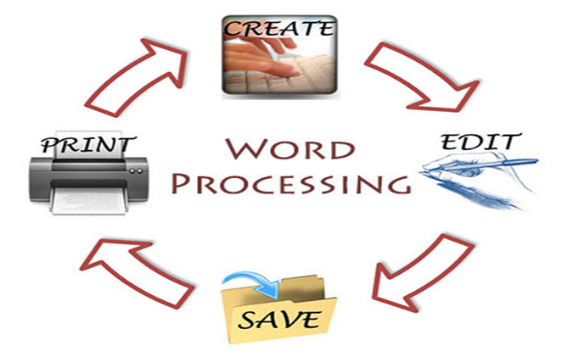
Word Processing Unit 7

Slide 2

Objectives:
-Learning about word processing;
-Introduce design concepts to enhance flyer aesthetics;
-Use future simple tense and present continuous in the future form to describe the process.

Slide 3
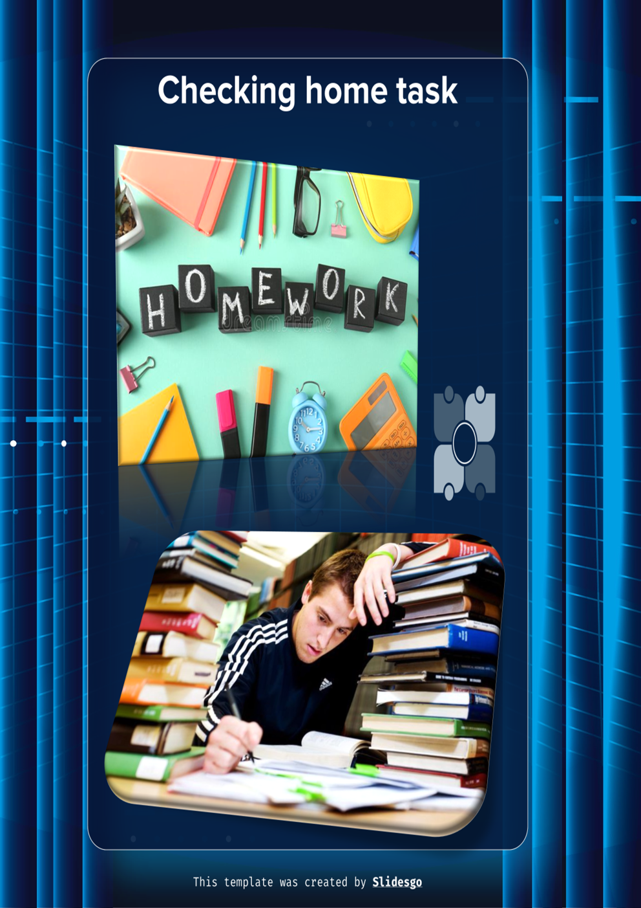

Slide 4
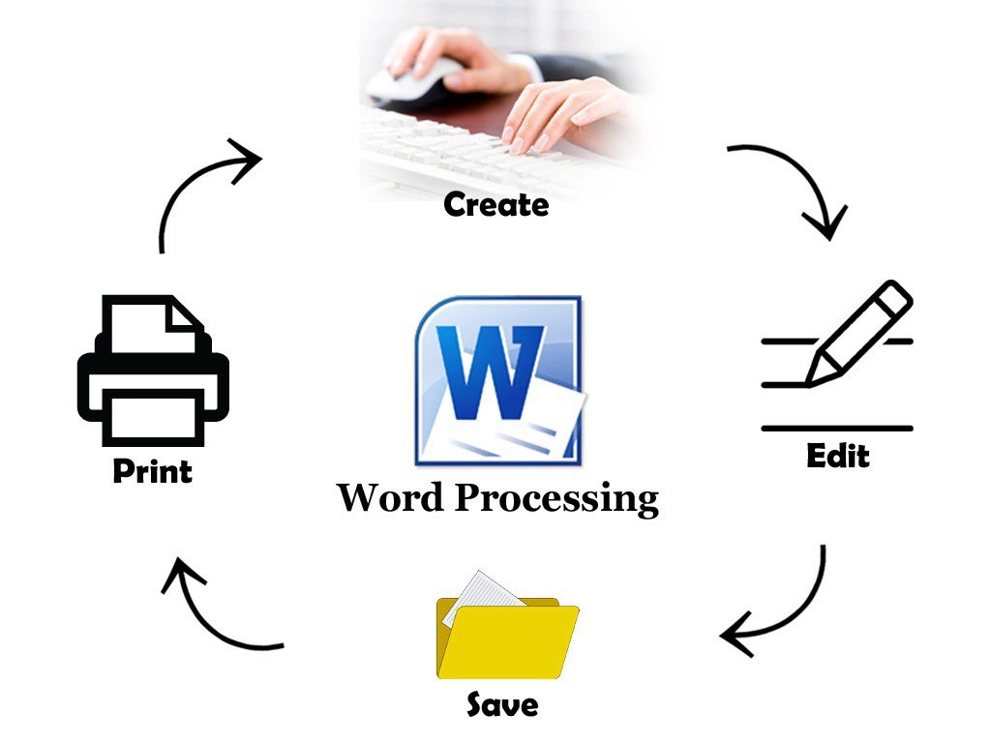
Talk about these questions
1. When do people
use word processing programs?
2. What kinds of word processing programs are there?

Slide 5
Display
Lead-in:
Ctrl +A ------ Select All
Ctrl + X ------ Cut
Ctrl + C------ Copy
Ctrl + V ------ Paste
Ctrl + P ------- Print window
Ctrl + B -----Bold selection
Ctrl + N ------ New document
Ctrl + Z ----- Undo last action
Ctrl + K ----- Insert link
Ctrl + U ----- underline
Ctrl + F ------- Open find box
Ctrl + H ----- Find and replace
Ctrl + W ----- Close
Alt + Tab ----- Switch Apps
Alt +F4 ------ Close apps
Ctrl +Esc ------ Open start menu

Slide 6


Slide 7
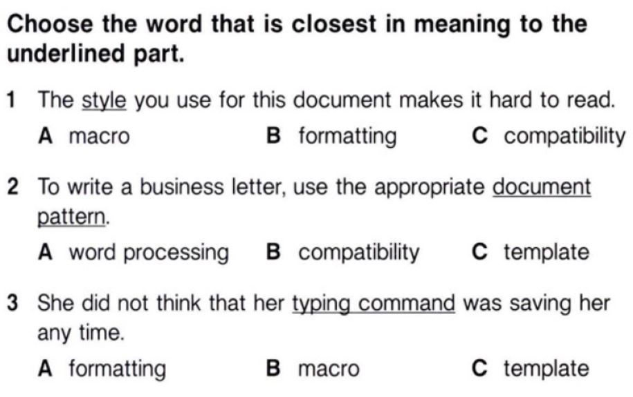
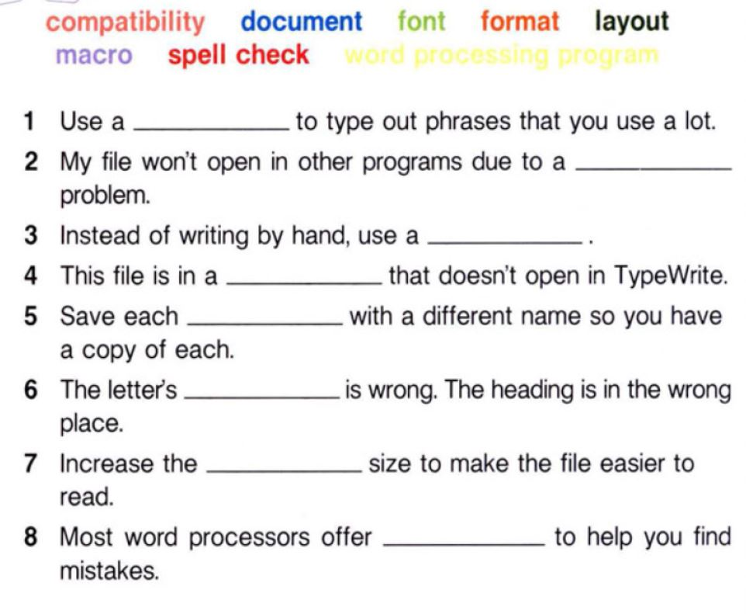
Fill in the blanks with the correct words and phrases
macro
compatibility
word processing program
format
document
layout
font
spell check

Slide 8
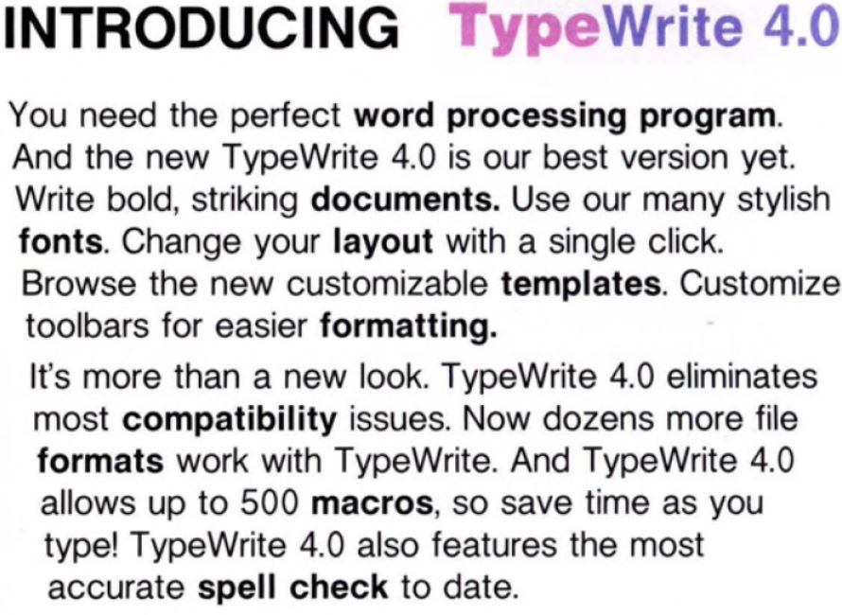
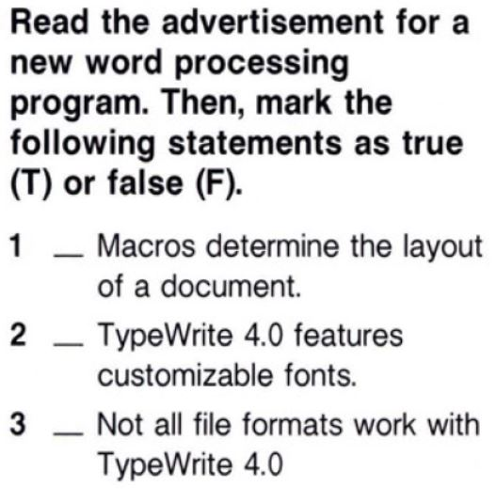
Computer icon pack
F
F
T

Slide 9

Listen to a conversation between IT professional and a computer user. Choose the correct answers.
1. What is the dialogue mostly about?
A how to open a file
B common word processing errors
C types of word processing programs
D ways to change file formats
2 What solution does the IT Professional suggest?
A buy the TypeWrite program
B download the file and try again
C get the file in a different format
D ask the client to send a program

Slide 10
Listen again and complete the conversation
IT Professional: Technical Support, can I help you?
User: Yes, I have a 1) _______ problem.
IT Professional: Okay. What seems to be wrong?
User: I have a file from a client, but it won’t 2) ____________.
IT Professional: What kind of file is it? And what program are you using?
User: It's in ‘.tpw’ 3) ________. I use Typing Suite.
IT Professional: Oh, that’s a TypeWrite file. It isn’t 4) ________ with Typing Suite.
User: Oh no. I need that 5) ______.
IT Professional: Have the client send it as a “.txt” file. That opens in most 6) ________.
User: Great, thanks!

Slide 11
Grammar Focus: Future Simple and Present Continuous in the future
The future simple tense is used to talk about actions or events that will happen in the future.
The present continuous tense can also be used to talk about future plans or arrangements.
S +will + base form of the verb
Positive (+) | Negative (-) | Question (?)
I will finish typing the document tomorrow. | I will not finish typing the document tomorrow. | Will you finish typing the document tomorrow?

Slide 12
The present continuous tense can also be used to talk about future plans or arrangements.
S + am/is/are +V+ing
She is editing the article tomorrow.
We are reviewing the draft in the morning. (This statement describes the task that is already planned or arranged in the context of word processing)

Slide 13
Choose the correct tense (Future Simple or Present Continuous) for each sentence.
1.By next week, I __________ (will complete / am completing) the document formatting.
2. Tomorrow at 3 PM, she __________ (is editing / will edit) the final draft of the report.
3. They __________ (will add / are adding) the table of contents after lunch today.
4. I __________ (am proofreading / will proofread) the article before sending it to the editor this evening. 5 Next Monday, our team __________ (is discussing / will discuss) the changes to the word processing guidelines. 6. He __________ (will save / is saving) the file as soon as he finishes typing.
Answers: 1. will complete; 2. is editing; 3. are adding; 4. will proofread; 5. is discussing; 6. will save.

Slide 14
Hands-on Practice
Practice formatting, editing, and designing documents.
• Open a New Document;
• Set Document Properties (Name the document. Set margins and orientation);
• Insert and Format Text (Format the title using different font styles, sizes, and colors to make it stand out);
• Add Event Details (e.g., bullet points, bold for headings);
• Choose and Insert Images (e.g., event photos, logos);
• Add Decorative Elements (Use shapes, lines, or clip art from the software’s gallery to enhance the flyer’s design);
• Preview and Adjust (Make adjustments to spacing, alignment, or sizing if necessary).

Slide 15
Create a flyer to apply learned skills
- Exchange flyers with classmates for feedback.
- Provide constructive criticism on design elements, clarity of information, and overall effectiveness.
- Present the revised flyer design to the class, highlighting changes made based on peer feedback.
- Discuss the design choices and improvements made during the process.

Slide 16

The image of a probable flyer

Slide 17

Home Assignment
Design your logo for your future company.

Slide 18

Any questions?
Thank you for your attention
+

Slide 19


Email Unit 8

Slide 20
Objectives:
1. Familiarize with the format of emails;
2. Practice drafting professional responses to emails, demonstrating proper tone and content based on the message received;
3. Compose a concise email.

Slide 21
Discuss the questions
1. How is email helpful to people and businesses?
2. What are some problems with email?

Slide 22

Enhance your vocabulary https://quizlet.com/668845997/flashcards https://quizlet.com/668845997/test

Slide 23
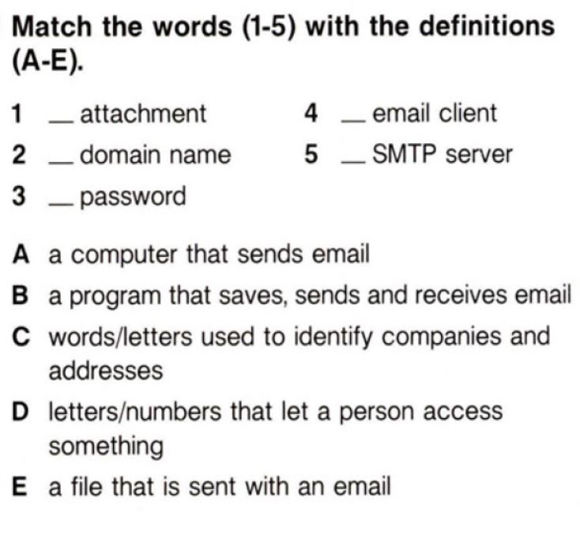
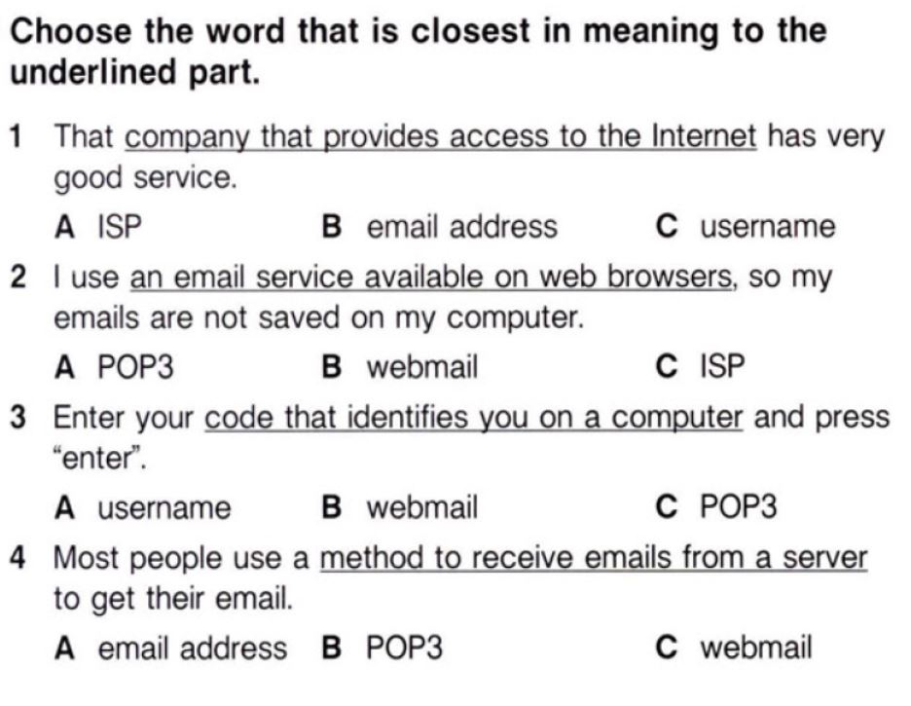
Computer icon pack
E
B
C
A
D

Slide 24

Racing

Slide 25
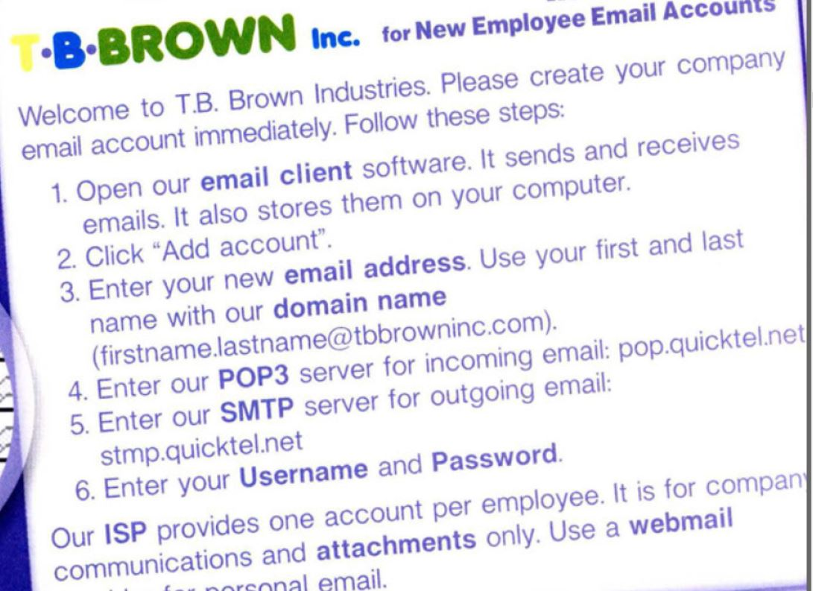
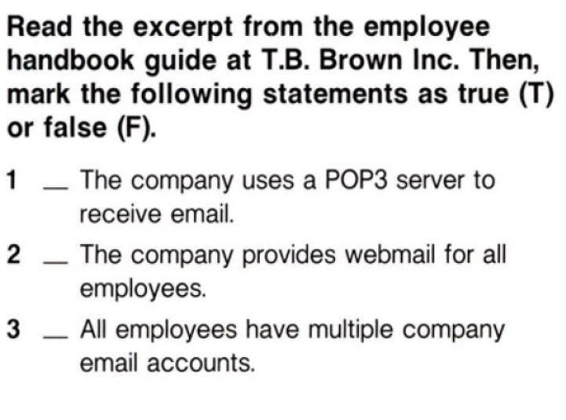
T
F
F
+

Slide 26

Listen to a conversation between a QuickTel employee and a customer. Choose the correct answers.
1. What are the speakers mostly talking about?
A. how to create a new email address
B. why a customer is not pleased with QuickTel
C. when to enter a username and password
D. what's wrong with a customer's email
2. Which of the following is NOT a potential cause of the customer's problem?
A. username
B. password
C. POP3 settings
D. webmail account

Slide 27
Listen again and complete the conversation
Employee: Thanks for calling QuickTel. How may I help you?
Customer: Well, I’m a new customer, and my 1) _________ isn't receiving mail.
Employee: Okay. Do you have the correct 2) ______________ and 3)_________?
Customer: Yes. Those work fine.
Employee: Okay, do you have a 4) _____________ account or an email client? There are some common mistakes with those.
Customer: An 5)________ ? Does that matter?
Employee: New customers often make mistakes with the 6) ________ settings. The correct server is POP.QuickTel.net.
Customer: Oh, that's it. I have POP.QuickTel.com. Thanks.
Answers: 1) word processing 2) open 3) format 4) compatible 5) information 6) programs

Slide 28
Go through each guideline listed in Mr. Khakimov’s email. Discuss why each guideline is important for effective communication within the company. Subject: Guidelines for Using Email Effectively at Company Brown. Inc Dear Team, I hope this message finds you well. As part of our efforts to enhance communication efficiency and clarity at Brown.inc, I would like to provide you with some guidelines on how to use email effectively. Clear and professional communication via email is crucial in our daily operations, so please take a moment to review the following recommendations:

Slide 29
Use Clear and Informative Subject Lines: ▪ Always use a concise and descriptive subject line that summarizes the content of your email. This helps recipients prioritize and understand the context at a glance. Be Mindful of Tone and Language: ▪ Maintain a professional tone in all communications. Avoid using informal language, emojis, or abbreviations that may be unclear or misinterpreted.
Keep Emails Brief and to the Point: ▪ Respect your colleagues' time by keeping emails concise and focused on the main message. Use paragraphs and bullet points to break down information if necessary. Proofread Before Sending: ▪ Always proofread your emails for grammar, spelling, and clarity before hitting "Send." This helps to maintain professionalism and avoid misunderstandings.

Slide 30
Reply Promptly and Acknowledge Receipt: ▪ Respond to emails in a timely manner, even if it's to acknowledge receipt and indicate when a detailed response will follow. This shows respect for the sender's time. Use Email Signatures: ▪ Include a standardized email signature at the end of your messages. This typically includes your full name, job title, contact information, and any relevant links or disclaimers.
Consider Confidentiality and Security: ▪ Exercise caution when discussing sensitive information via email. Use encryption or secure channels if necessary, and be mindful of company policies on data protection. Use Reply vs. Reply All Appropriately: ▪ Use "Reply All" only when all recipients need to see your response. Avoid unnecessary email clutter by replying directly to the sender when the response is not relevant to all.

Slide 31
File and Organize Emails Efficiently: ▪ Maintain organized email folders to store and retrieve messages easily. Use meaningful labels or categories to categorize emails by project, client, or topic. Follow Up as Needed: ▪ If you're waiting for a response or action from someone, don't hesitate to follow up politely after a reasonable period. This helps to keep workflows moving smoothly.
These guidelines are designed to help streamline communication and ensure that our emails are effective tools for collaboration and information exchange. If you have any questions or need further clarification on these guidelines, please don't hesitate to reach out. Thank you for your attention to these recommendations. Let's continue to work together to maintain clear and efficient communication across Brown.inc company. Best regards, Mr. Khakimov Project Manager at Brown.inc

Slide 32
Read again the provided email and learn the format of it
Subject: [Brief and Clear Subject Line]
Dear [Recipient's Name],
[Opening greeting or polite introduction]
[Body of the email, which includes the main message, details, and any necessary information]
[Closing remarks, such as a call to action, request for feedback, or next steps]
[Closing greeting (e.g., Best regards, Sincerely, Regards)]
[Your Name]
[Your Position]
[Company Name]
[Contact Information]

Slide 33
Analyze the letter. What’s wrong with it? Find 5 grammar mistakes in this letter
Dear Team,
I hope you're all doing good. I wanted talking about how important it is to have a strong networking setup in our company. Networking really helps us communicate better and work more efficiently together.
To make sure everything run smoothly, we should thinking about upgrading our current network equipment. This will reduce downtime and make us more productive. Also, using secure protocols and keeping everything maintained will keep our data safe from any problems.
We'll also organize training sessions to help everyone get used to the new network systems. This make it easier for us to use the networking tools well and do our work better.
Thank you for helping out with this. If you have any questions or ideas, please let me know.
Best regards,
Mr. Alisherov

Slide 34
Analyze the letter. What’s wrong with it?
Subject: Important Networking Update
Dear Team,
I trust you are well. Networking is crucial for our company. It helps us work together.
We need to upgrade our network hardware. Don’t you think so? Secure protocols and regular maintenance are also important.
Training sessions will happen to help everyone with the new network systems. This will help us use networking tools.
Any questions, please ask.
Best regards,
Mr. Anvarov

Slide 35

Rewrite parts of the emails to reflect a more suitable tone

Slide 36
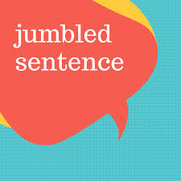
Arrange these jumbled sentences into a proper email format

Slide 37
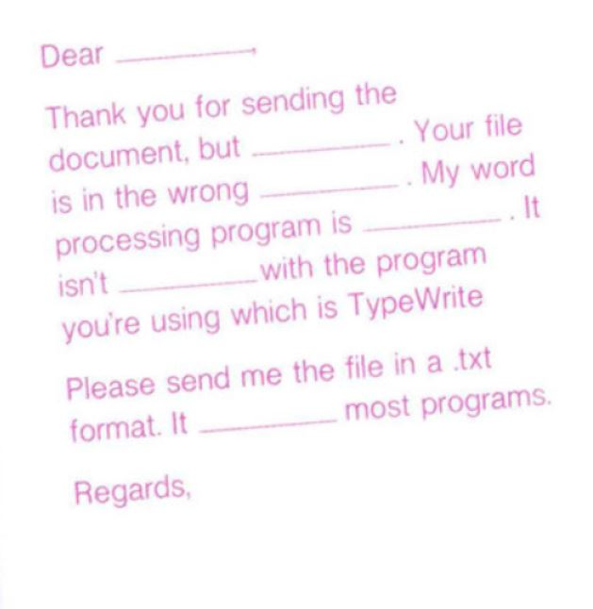
Fill in the email. Make up a name for the user.

Slide 38
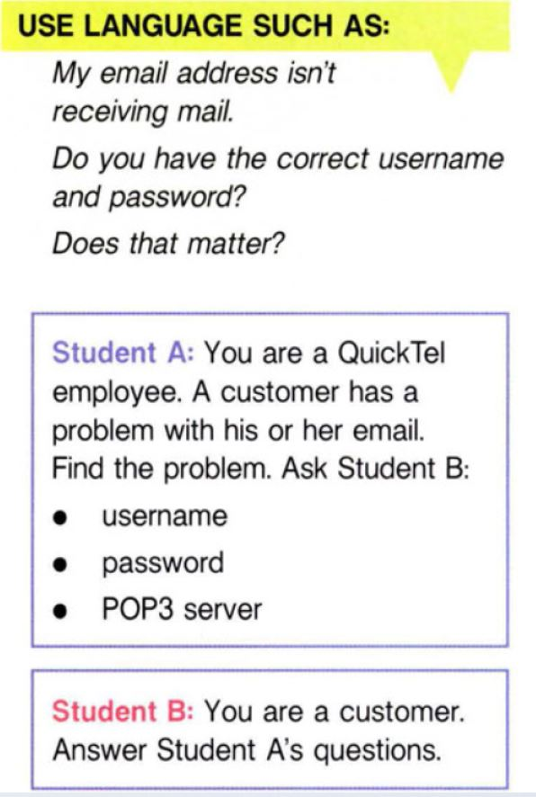
Speaking

Slide 39
Next assignment
Write an email asking to solve a problem.
Email Self-Check Checklist:
1. Subject Line
2. Recipient
3. Opening
4. Body
5. Politeness and Tone
6. Closing
7. Attachment (if applicable)
+

Slide 40

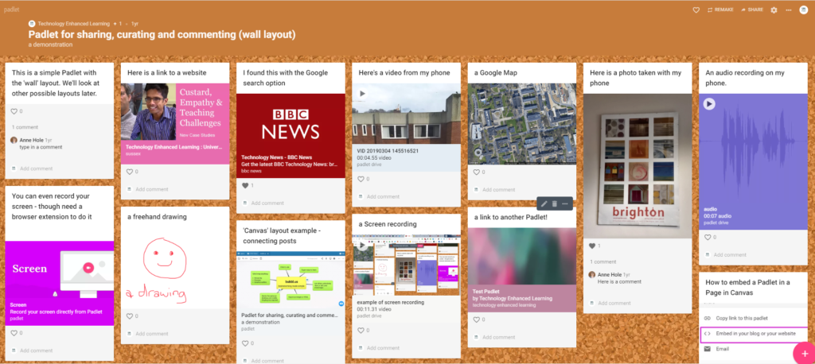
Upload your letter to the Padlet.com
https://padlet.com/zulyauz/padlet-e2k2k79pdlnhz9uq

Slide 41


You’ve been great!
Keep up learning!

